Slide 1
GUIs: Event-Driven Programming
Complete JFrames

Slide 2
JFrames
Complete Window objects
They don't do anything until told to
An event, such as a menu choice, signals the JFrame to respond.
This is called Event-Driven Programming

Slide 3
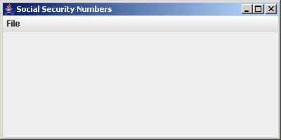
"Three Tier Architecture"
Program Logic
Data
(files)
Decisions
Based on
the User's
Choices
Data Available for the user's choice
Graphical
User
Interface

Slide 4
All the main program needs to do is instantiate the GUI
public class SSNMain {
static SSNGUI ssnGUI;
public static void main(String[] args) {
ssnGUI = new SSNGUI("My SSN GUI", 400,200);
}
}
ssnGUI
SSNGUI

Slide 5
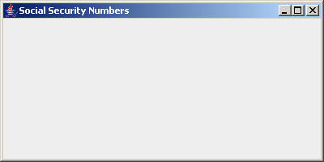
public SSNGUI(String title, int height, int width) {
setTitle(title);
setSize(height,width);
setLocation (400,200);
setDefaultCloseOperation(EXIT_ON_CLOSE);
setVisible(true);
} //SSNGUI

Slide 6
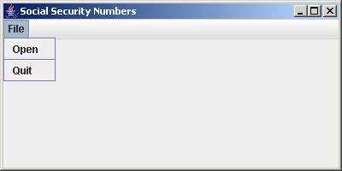
Add a menu...
public SSNGUI(String title, int height, int width) {
setTitle(title);
setSize(height,width);
setTitle("Social Security Numbers");
setLocation(400,200);
createMenu();
setDefaultCloseOperation(EXIT_ON_CLOSE);
setVisible(true);
}

Slide 7
The basics of creating drop-down menus...
private void createMenu( ) {
JMenuBar menuBar = new JMenuBar();
JMenu fileMenu = new JMenu("File");
JMenuItem item;
FileMenuHandler fmh = new FileMenuHandler(this);
item = new JMenuItem("Open");
item.addActionListener( fmh );
fileMenu.add( item );
fileMenu.addSeparator();
item = new JMenuItem("Quit");
item.addActionListener( fmh );
fileMenu.add( item );
setJMenuBar(menuBar);
menuBar.add(fileMenu);
} //createMenu

Slide 8
private void createMenu( ) {
JMenuBar menuBar = new JMenuBar();
JMenu fileMenu = new JMenu("File");
JMenuItem item;
} //createMenu

Slide 9
private void createMenu( ) {
JMenuBar menuBar = new JMenuBar();
JMenu fileMenu = new JMenu("File");
JMenuItem item;
FileMenuHandler fmh = new FileMenuHandler(this);
item = new JMenuItem("Open");
item.addActionListener( fmh );
fileMenu.add( item );
fileMenu.addSeparator();
item = new JMenuItem("Quit");
item.addActionListener( fmh );
fileMenu.add( item );
setJMenuBar(menuBar);
menuBar.add(fileMenu);
} //createMenu

Slide 10
private void createMenu( ) {
JMenuBar menuBar = new JMenuBar();
JMenu fileMenu = new JMenu("File");
JMenuItem item;
FileMenuHandler fmh = new FileMenuHandler(this);
item = new JMenuItem("Open");
item.addActionListener( fmh );
fileMenu.add( item );
fileMenu.addSeparator();
item = new JMenuItem("Quit");
item.addActionListener( fmh );
fileMenu.add( item );
menuBar.add(fileMenu);
setJMenuBar(menuBar);
} //createMenu
Put the fileMenu in the menuBar
Put the menuBar in the JFrame

Slide 11
Now we handle the events
private void createMenu( ) {
JMenuBar menuBar = new JMenuBar();
JMenu fileMenu = new JMenu("File");
JMenuItem item;
FileMenuHandler fmh = new FileMenuHandler(this);
item = new JMenuItem("Open");
item.addActionListener( fmh );
fileMenu.add( item );
fileMenu.addSeparator();
item = new JMenuItem("Quit");
item.addActionListener( fmh );
fileMenu.add( item );
menuBar.add(fileMenu);
setJMenuBar(menuBar);
} //createMenu

Slide 12
An event is something that happens while the program is running
The user clicks on the X to close the window
The user chooses an item from a menu
Click on this

Slide 13
Events need to be handled
An Event Handler is a method that is automatically called when an event, such as choosing a menu item, occurs.
An Event Handler can handle more than one event, but each event needs a handler (or nothing will happen)
Event Handlers are written in a class that implements an interface called ActionListener

Slide 14
What is an Interface?
An Interface is a collection of method headings only (not bodies).
Interfaces are implemented by a Java class
If an interface is implemented, all methods specified in the interface must be provided by that class
An interface, if implemented, guarantees that all methods will be defined.
public interface X {
public int y (int z);
public void q();
}
public class A implements X {
public int y (int z) { return z+1 )
public void q() { }
}

Slide 15
Interface ActionListener
Contains a method heading actionPerformed(ActionEvent)
The actionPerformed method is called when an event happens.
Each event needs to be registered with some ActionListener
FileMenuHandler (implements ActionListener)
actionPerformed called

Slide 16
private void createMenu( ) {
JMenuBar menuBar = new JMenuBar();
JMenu fileMenu = new JMenu("File");
JMenuItem item;
FileMenuHandler fmh = new FileMenuHandler(this);
item = new JMenuItem("Open");
item.addActionListener( fmh );
fileMenu.add( item );
fileMenu.addSeparator();
item = new JMenuItem("Quit");
item.addActionListener( fmh );
fileMenu.add( item );
menuBar.add(fileMenu);
setJMenuBar(menuBar);
} //createMenu
Here, clicking on open or on quit will call the actionPerformed method of the FileMenuHandler class

Slide 17
...
FileMenuHandler fmh = new FileMenuHandler(this);
item = new JMenuItem("Open");
item.addActionListener( fmh);
item = new JMenuItem("Quit");
item.addActionListener( fmh );
...
fmh
item

Slide 18
...
FileMenuHandler fmh = new FileMenuHandler(this);
item = new JMenuItem("Open");
item.addActionListener( fmh);
item = new JMenuItem("Quit");
item.addActionListener( fmh );
...
fmh
item
FileMenuHandler
public FileMenuHandler (JFrame jf) {
jframe = jf;
}

Slide 19
...
FileMenuHandler fmh = new FileMenuHandler(this);
item = new JMenuItem("Open");
item.addActionListener( fmh);
item = new JMenuItem("Quit");
item.addActionListener( fmh );
...
fmh
item
FileMenuHandler
public FileMenuHandler (JFrame jf) {
jframe = jf;
}

Slide 20
...
FileMenuHandler fmh = new FileMenuHandler(this);
item = new JMenuItem("Open");
item.addActionListener( fmh);
item = new JMenuItem("Quit");
item.addActionListener( fmh );
...
fmh
item
FileMenuHandler
public FileMenuHandler (JFrame jf) {
jframe = jf;
}

Slide 21
...
FileMenuHandler fmh = new FileMenuHandler(this);
item = new JMenuItem("Open");
item.addActionListener( fmh);
item = new JMenuItem("Quit");
item.addActionListener( fmh );
...
fmh
item
FileMenuHandler
public FileMenuHandler (JFrame jf) {
jframe = jf;
}

Slide 22
...
FileMenuHandler fmh = new FileMenuHandler(this);
item = new JMenuItem("Open");
item.addActionListener( fmh);
item = new JMenuItem("Quit");
item.addActionListener( fmh );
...
fmh
item
FileMenuHandler
public FileMenuHandler (JFrame jf) {
jframe = jf;
}

Slide 23
...
FileMenuHandler fmh = new FileMenuHandler(this);
item = new JMenuItem("Open");
item.addActionListener( fmh);
item = new JMenuItem("Quit");
item.addActionListener( fmh );
}
FileMenuHandler
public FileMenuHandler (JFrame jf) {
jframe = jf;
}

Slide 24
FileMenuHandler
public FileMenuHandler (JFrame jf) {
jframe = jf;
}
Suppose the user clicks on "Open"
An ActionEvent object is created
Open
The actionPerformed method of the handler that is registered with the event is called.
The ActionEvent is passed to it as a parameter

Slide 25
FileMenuHandler
public FileMenuHandler (JFrame jf) {
jframe = jf;
}
Open
public void actionPerformed(ActionEvent event) {
String menuName;
menuName = event.getActionCommand();
if (menuName.equals("Open"))
openFile( );
else if (menuName.equals("Quit"))
System.exit(0);
} //actionPerformed
event

Slide 26
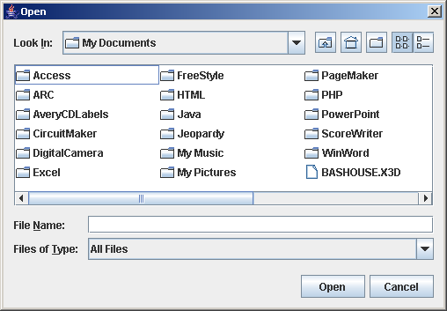
FileMenuHandler
public FileMenuHandler (JFrame jf) {
jframe = jf;
}
private void openFile( ) {
int status;
JFileChooser chooser = new JFileChooser( );
status = chooser.showOpenDialog(null);
readSource(chooser.getSelectedFile());
} //openFile

Slide 27
FileMenuHandler
public FileMenuHandler (JFrame jf) {
jframe = jf;
}
private void readSource(File chosenFile) {
String chosenFileName = chosenFile.getName();
TextFileInput inFile = new TextFileInput(chosenFileName);
String ssn;
int subscript = 0;
Container myContentPane = jframe.getContentPane();
JTextArea myTextArea = new JTextArea();
JTextArea mySubscripts = new JTextArea();
myContentPane.add(myTextArea, BorderLayout.EAST);
myContentPane.add(mySubscripts, BorderLayout.WEST);
...

Slide 28
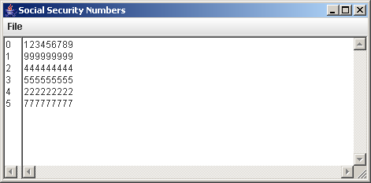
... ssn = inFile.readLine();
while (ssn != null) {
mySubscripts.append(Integer.toString(subscript++)+"\n");
myTextArea.append(ssn+"\n");
ssn = inFile.readLine();
} //while
jframe.setVisible(true);

Slide 29
Main program starts and instantiates a GUI
GUI creates its JMenuBar, JMenu and JMenuItems
GUI registers each JMenuItem with one or more ActionListeners
User clicks on a JMenuItem
The actionPerformed method in the handler registered with that JMenuItem is called
GUI waits for another event to happen

